Slide 1
Course Name: Machine Learning for Theory and Practices(CSE 623) Group Details: Rampal Singh (AU 2449006)
Project Name:
Predicting Tensile Strength in 3D-Printed Materials using Linear Regression AdaBoost Regression XGBoost Regression ,Gradient Boosting Regression Random Forest Regression

Slide 2
Problem statement
Developing a machine learning model to predict optimal printing parameters (such as layer height, infill density, nozzle temperature, print speed) to maximize tensile strength
The mechanical properties of 3D-printed materials, particularly tensile strength, are influenced by multiple factors such as layer height, infill density, print speed, and wall thickness. Accurately predicting tensile strength can help in optimizing print settings for better durability and performance. This project aims to develop a predictive model using Random Forest Regression to estimate tensile strength based on key printing parameters.

Slide 3
Literature Survey
Title | Authors | Key Parameters | ML Methods | Main Findings | Limitations
Accurate Estimation of Tensile Strength of 3D Printed Parts Using Machine Learning Algorithms | Jayasudha et al. | Extrusion temperature, layer height, shell thickness, build orientation | Linear Regression, Random Forest, AdaBoost, Gradient Boosting, XGBoost | XGBoost outperformed others (R²: 0.94–0.97). Tensile strength correlates strongly with extrusion temperature. | Limited to two case studies; hyperparameters not globally optimized.
Predicting the Dimensional Variation of Geometries Produced Through FDM 3D Printing | Sharma et al. | Wall thickness, infill density, print speed, material (ABS/PLA) | Decision Tree Regression | PLA exhibits higher dimensional variation than ABS. Achieved R² = 0.67 for dimensional accuracy prediction. | Moderate R² score; limited to FDM and specific geometries.
Predicting Three-Dimensional (3D) Printed Part Quality with Machine Learning-Based Regression Methods | Tatar | Layer height, nozzle/bed temperature, infill density, material (PLA/ABS), fan speed | Gaussian Process Regression (GPR), SVM, MLP, Random Forest, Linear Regression | GPR achieved highest accuracy (R²: 0.98–1.00). MLP offered fastest prediction (6,700 obs/sec). | Computationally intensive for GPR; dataset limited to Kaggle’s open-source.
Automated Process Monitoring in 3D Printing Using Supervised Machine Learning | Delli & Chang | Layer thickness, material (ABS/PLA), checkpoints, image analysis | SVM (classification) | Detects structural and completion defects with 93-100% accuracy. Reduces material waste by early defect detection. | Requires pausing printing; limited to top-view defect detection.

Slide 4
Literature Survey
Title | Authors | Key Parameters | ML Methods | Main Findings | Limitations
Detecting Malicious Defects in 3D Printing Process Using Machine Learning and Image Classification | Wu et al. | Infill patterns (honeycomb, concentric, etc.), defect types (seam, irregular polygon, circle, rectangle, triangle), grayscale features (mean, SD, pixel count) | Naive Bayes Classifier, J48 Decision Trees | J48 achieved 95.51% accuracy in detecting malicious infill defects. Features extracted from simulated layer-by-layer images. | Tested only on simulated images; limited to honeycomb infill patterns; defects not validated in physical environments.

Slide 5
Dataset Discussion
Aspect | Details
Dataset Source | Experimental data collected from kaggle and Research papers
Features Considered | - Wall Thickness
 | - Infill Density
 | - Layer Height
 | - Bed Temperature
 | - Nozzle Temperature
 | - Fan Speed
 | - Print Speed
Target Variable | Tensile Strength
Data Pre-processing Steps | - Removed non-numeric data
 | - Handled missing values by imputing with the column mean
 | - Split data into training (80%) and testing (20%) sets

Slide 6
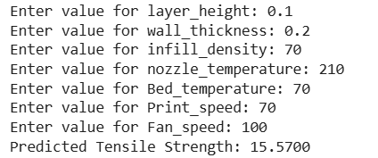
My approach
Selecting best ML best hypothesis out of Linear Regression AdaBoost Regression XGBoost Regression ,Gradient Boosting Regression Random Forest Regression by comparing performance parameters like mean square error and R square value
Linear Regression - MSE: 24.5873, R2 Score: 0.5923
AdaBoost Regression - MSE: 19.8158, R2 Score: 0.6714
XGBoost Regression - MSE: 19.1901, R2 Score: 0.6818
Gradient Boosting Regression - MSE: 17.8845, R2 Score: 0.7035
Random Forest Regression - MSE: 14.0622, R2 Score: 0.7668
Used Random Forest Regression for predicting tensile strength.

Slide 7
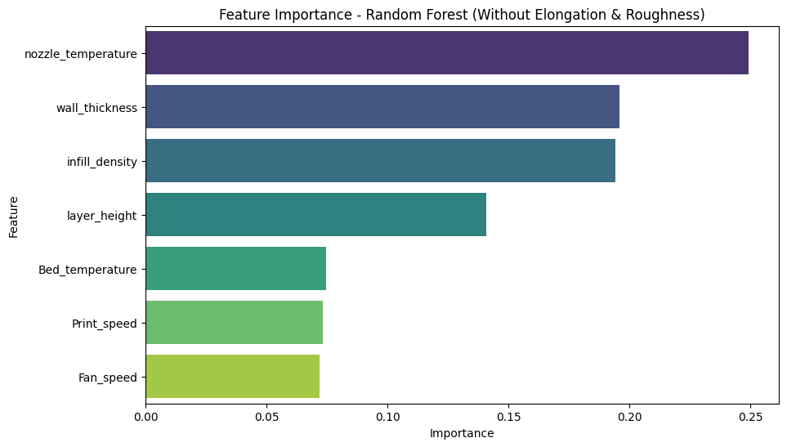
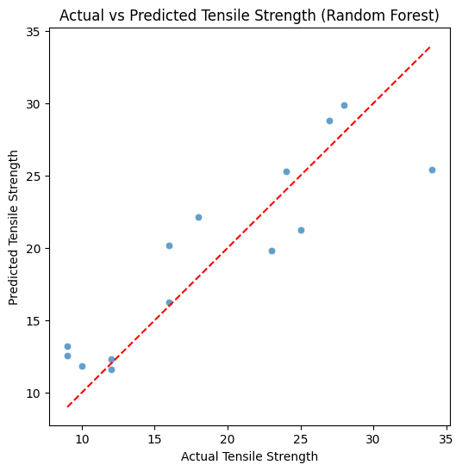

Slide 8
Future Work:
Perform hyperparameter tuning on AdaBoost Regression, XGBoost Regression, Gradient Boosting Regression, and Random Forest Regression to evaluate their impact on Mean Squared Error (MSE) and the coefficient of determination (R²).
Utilize additional data from the literature to enhance tensile strength predictions and integrate this data with the existing dataset. Retrain the model and analyze the subsequent changes in MSE and R² values.
Employ various feature importance techniques and compare the observed trends with findings from existing literature.

Slide 9
References
Delli, U., & Chang, S. (2018). Automated process monitoring in 3D printing using supervised machine learning. Procedia Manufacturing, 26, 865–870. https://doi.org/10.1016/j.promfg.2018.07.111
Jayasudha, M., Elangovan, M., Mahdal, M., & Priyadarshini, J. (2022). Accurate estimation of tensile strength of 3D printed parts using machine learning algorithms. Processes, 10(6), 1158. https://doi.org/10.3390/pr10061158
Tatar, A. B. (2025). Predicting three-dimensional (3D) printing product quality with machine learning-based regression methods. Fırat University Journal of Experimental and Computational Engineering, 4(1), 206–225. https://doi.org/10.62520/fujece.1604379
Sharma, P., Vaid, H., Vajpeyi, R., Shubham, P., Agarwal, K. M., & Bhatia, D. (2022). Predicting the dimensional variation of geometries produced through FDM 3D printing employing supervised machine learning. Sensors International, 3, 100194. https://doi.org/10.1016/j.sintl.2022.100194

